Slide 1
A Reinforcement Learning Approach to Ship Towing Using Two Tugboats
Name: Mohammad Saifullah Khan
Roll No.: 21169
TEAM:
Rahul Kulkarni
Mohammad Saifullah Khan

Slide 2
Problem Statement
Towing a ship to target location by two tugboats using Multi-Agent Deep Deterministic Policy Gradient (MADDPG)

Slide 3
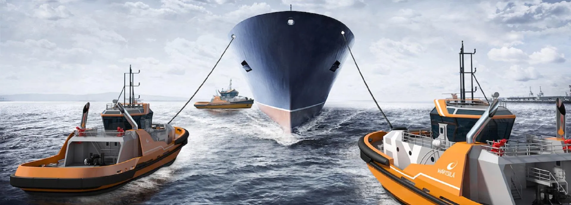
Challenges
Coordination among agents (tugboats).
High dimensional and continuous action space.
Scalability and complexity of task
Reward shaping and credit assignment.
Adaptation to different ship types and conditions.
Real world transfer of simulation.

Slide 4
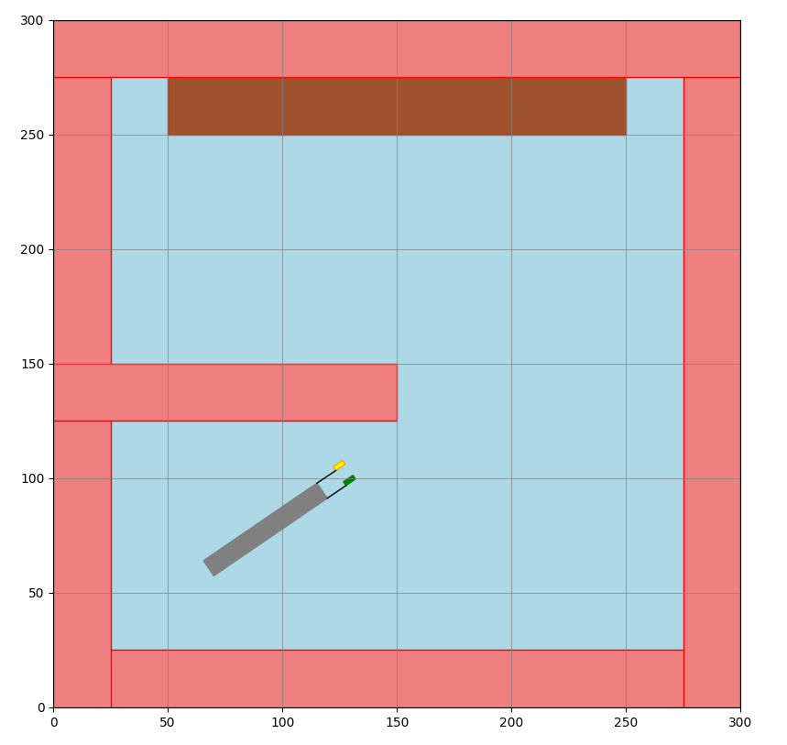
Approach
Built custom environment.
Observation space of each tugboat: ship position and orientation, position and orientation of own and other agent, distance of ship from target (Euclidean), rope length.
Action space of each tugboat: velocity in x and y direction.
Rope (black coloured) considered as a stiff rod for simplicity.
A force applied on ship due to movement of tugboats.
Agents = tugboats.
Obstacles: red coloured.
Dock: brown coloured.
Water: blue coloured

Slide 5
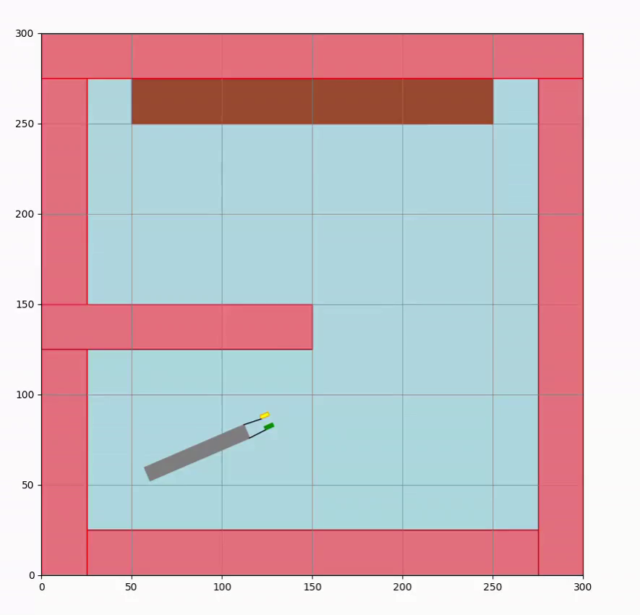

Slide 6
Reward structure:
R_{to_target} = - ds/(grid_size*0.004)
R_{proximity} = Penalty for coming close to obstacles
(for both ship and tugboats)
R_{in_target} = 1000
R_{rope_length} = penalty for exceeding rope length
R_{total} = R_{to_target} + R_{proximity} + R_{rope_length} + R_{in_target}

Slide 7
DDPG
Target
Q
Q (next)
Q
Critic
Critic
Critic
action
action
Actor
obs
action
Actor
obs
Obs (next)
Trained to maximize Q
minimize(Q - | reward + discount * Q_{next}|)

Slide 8
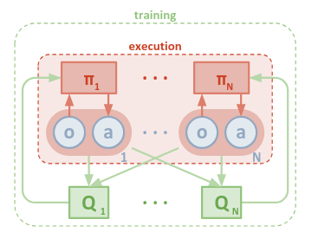
MADDPG
Soft update of parameters.
Θ_{target}​← τθ_{online}​+ (1−τ)θ_{target}
Handles continuous action spaces.
Sample efficiency
Training stability.
Centralized training, decentralized execution.
Source: https://arxiv.org/pdf/1706.02275

Slide 9
Parameters
Gamma = 0.99
Adam optimizer, learning rate = 0.003.
Tau = 0.01
Training episodes = 300, each with 2500 steps.

Slide 10
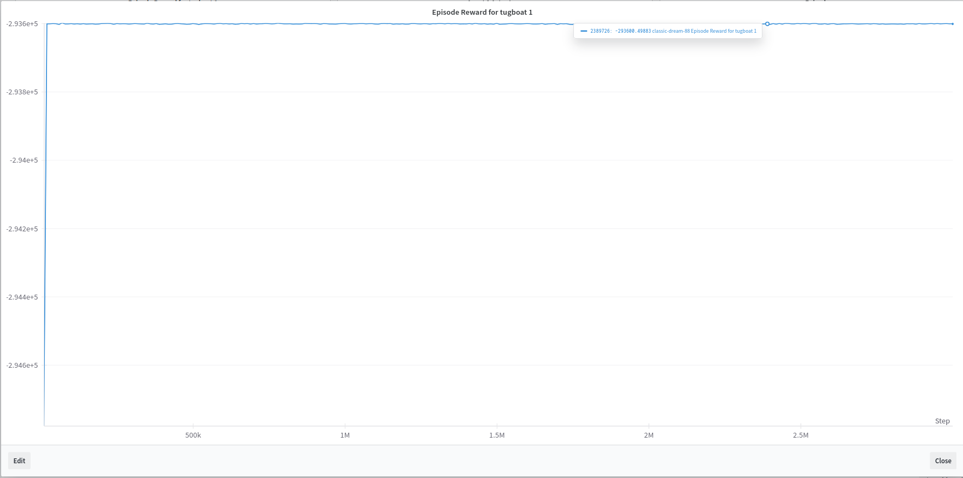
Results

Slide 11
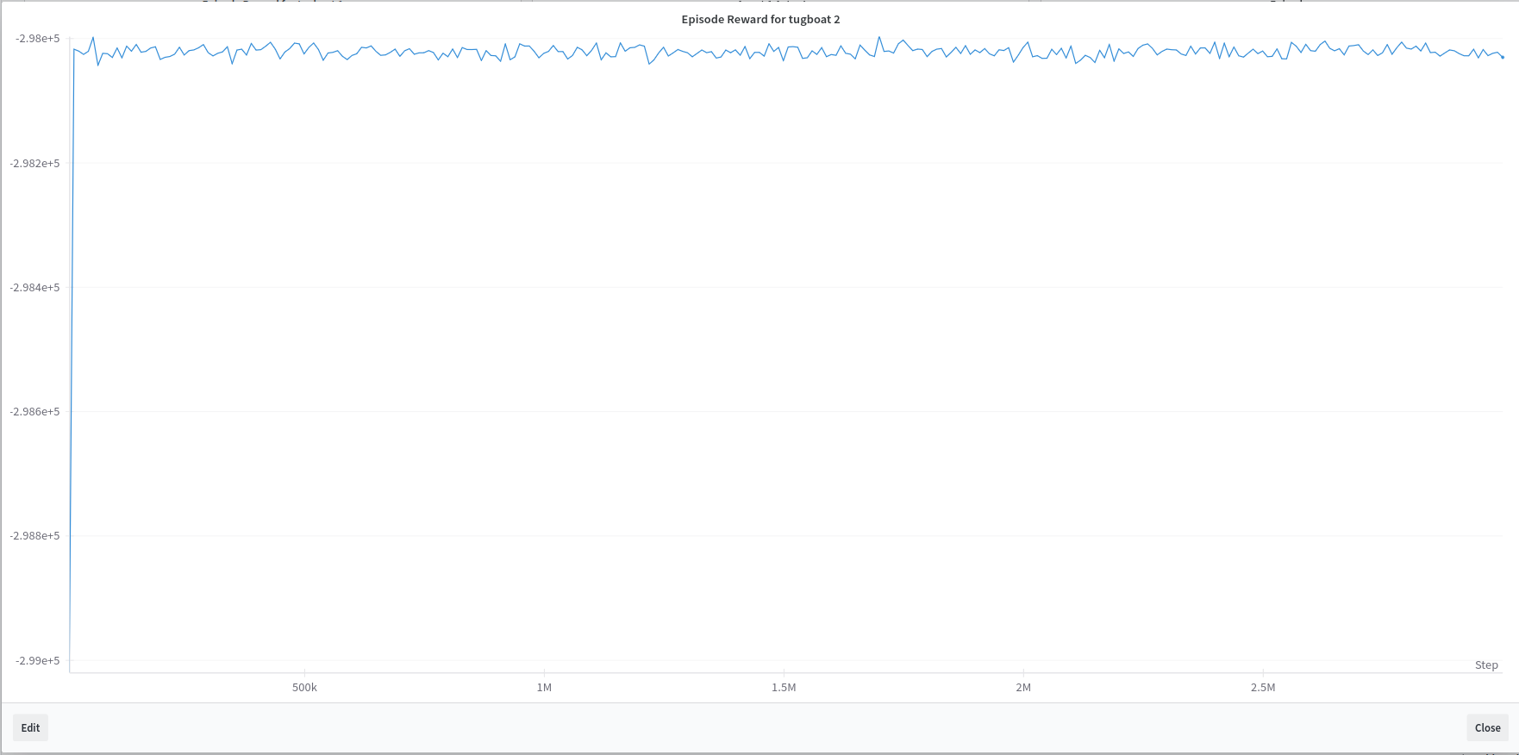

Slide 12
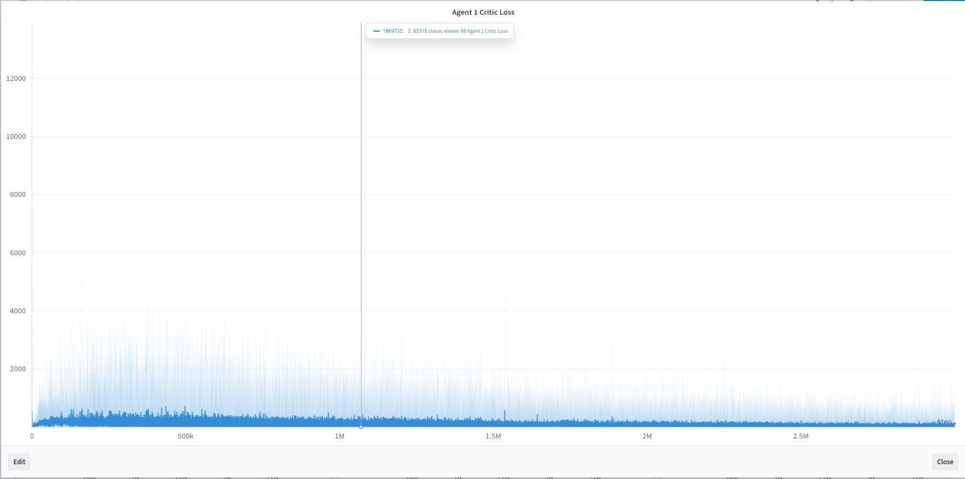

Slide 13
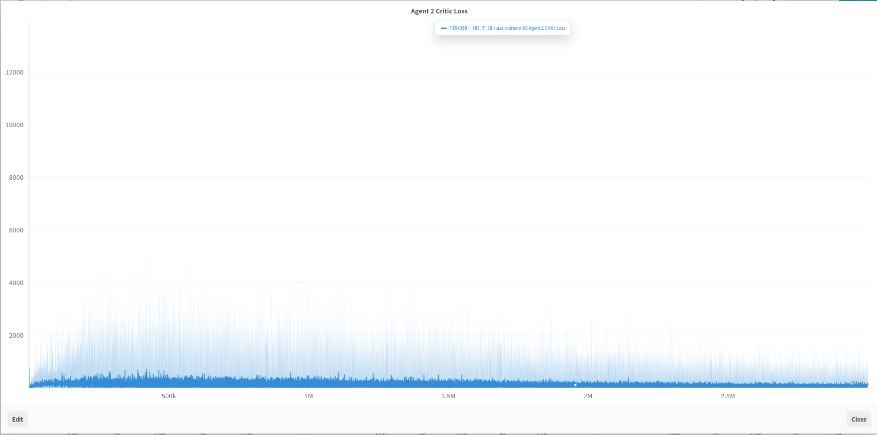

Slide 14
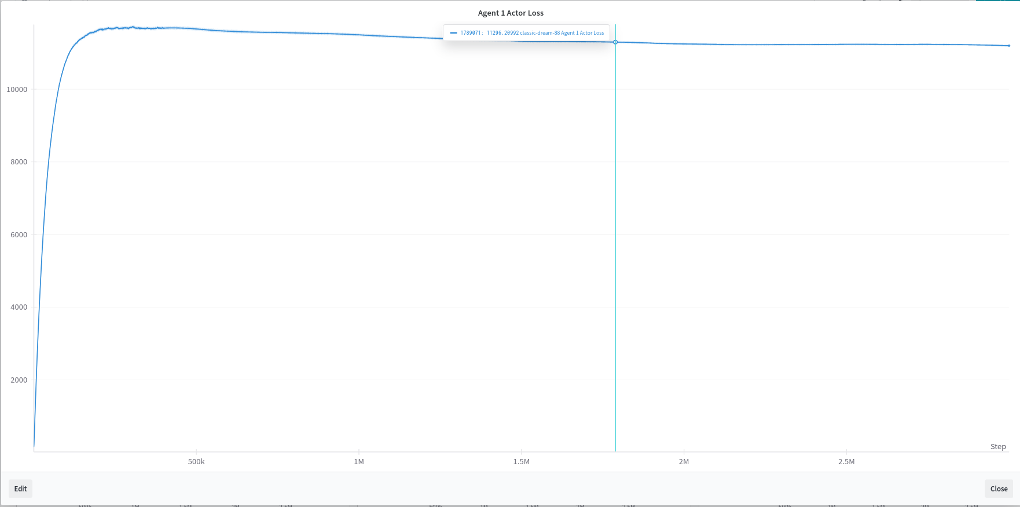

Slide 15
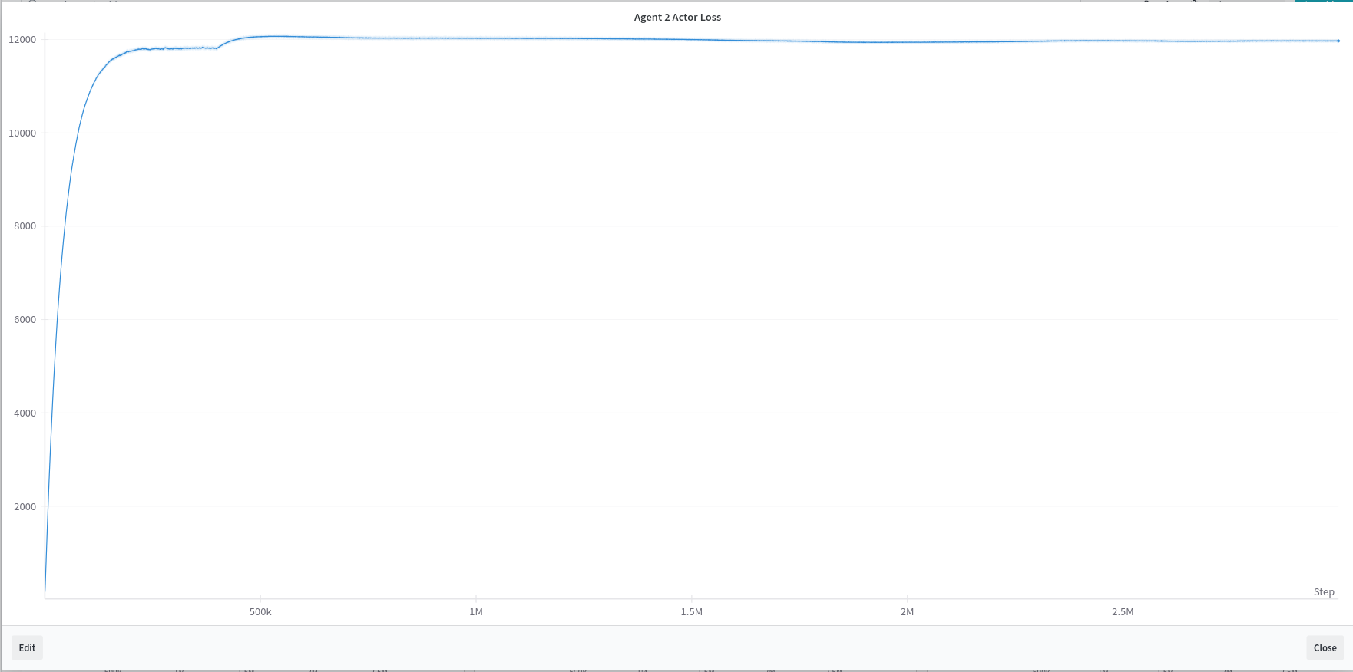

Slide 16
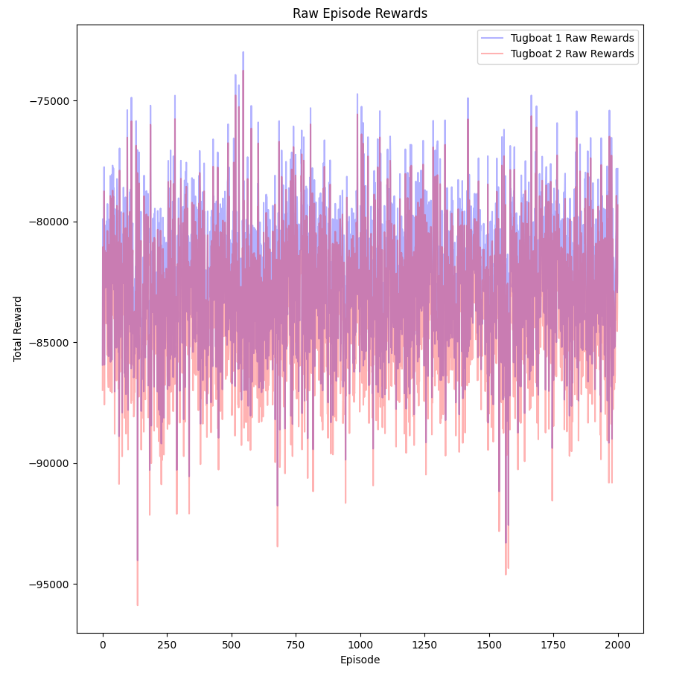
For random steps

Slide 17
Future Work
Improve reward structure.
Random spawn in the grid.
Add dynamic obstacles.
Managing traffic of multiple tugboat - ship combinations.

